Slide 1




Population ageing and decent work in ASEAN
Sabine Henning, PhD
Chief, Sustainable Demographic Transition Section, Social Development Division, ESCAP
Regional Conference on “Promoting Decent Work for Older Persons for an Inclusive Society in ASEA+3: Strengthening A More Resilient and Inclusive Society During and After the COVID-19 Pandemic” - 28-29 June 2021, Virtual Conference

Slide 2
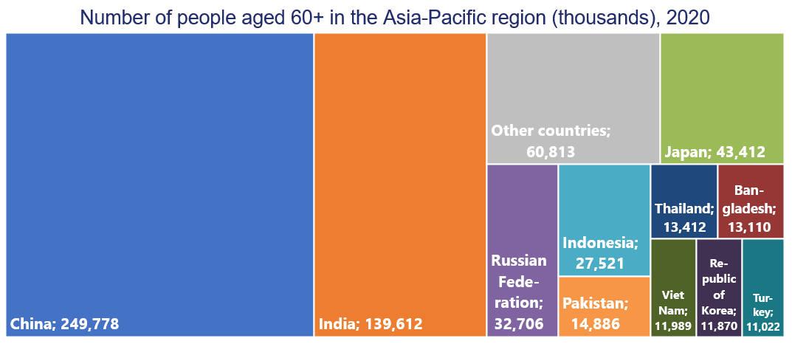
2020: Over 630 million older persons in the Asia-Pacific region – ASEAN+3 has some of the largest ageing populations
Source: United Nations, Department of Economic and Social Affairs, Population Division (2019), World Population Prospects 2019 . Accessed 23 April 2021.

Slide 3


ESCAP compiles and reports on population ageing data (www.population-trends-asiapacific.org)
https://bit.ly/3wTe5DH
https://bit.ly/35X7vjL

Slide 4

COVID-19 pandemic impact on older persons
Life and death
Serious morbidity and mortality rates from COVID-19 are significantly higher among older persons. An estimated 66% of people aged 70 and over have at least one underlying health condition.
Vulnerability
Essential health-care and social support that older persons often rely on is under pressure. Almost half of all COVID-19-related deaths worldwide have occurred in long-term care settings.
Mental health
Social distancing can take a heavy toll on the mental health of older persons. Living alone and being more digitally disconnected than others, the risks are higher for older persons
Economic well-being
The pandemic may significantly lower older persons’ incomes and living standards, compromising their overall access to health care and other health-related supports.
Responders
Older persons are not just passive victims. They are also responding. They are health workers, caregivers, and among many essential service providers.
Abuse and neglect
In 2017, 1 in 6 people were subjected to abuse. With lockdowns and reduced care, violence against older persons is on the rise.
Source: United Nations, “Policy brief: the impact of COVID-19 on older persons” (May 2020) Available at https://www.un.org/development/desa/ageing/wpcontent/uploads/sites/24/2020/05/COVID-Older-persons.pdf

Slide 5
Shifting age structures in Asia-Pacific
Source: United Nations, Department of Economic and Social Affairs, Population Division (2019), World Population Prospects 2019 - Special Aggregates, Online Edition. Rev 1; United Nations, Department of Economic and Social Affairs, Population Division (2019). Accessed 27 April 2021.

Slide 6
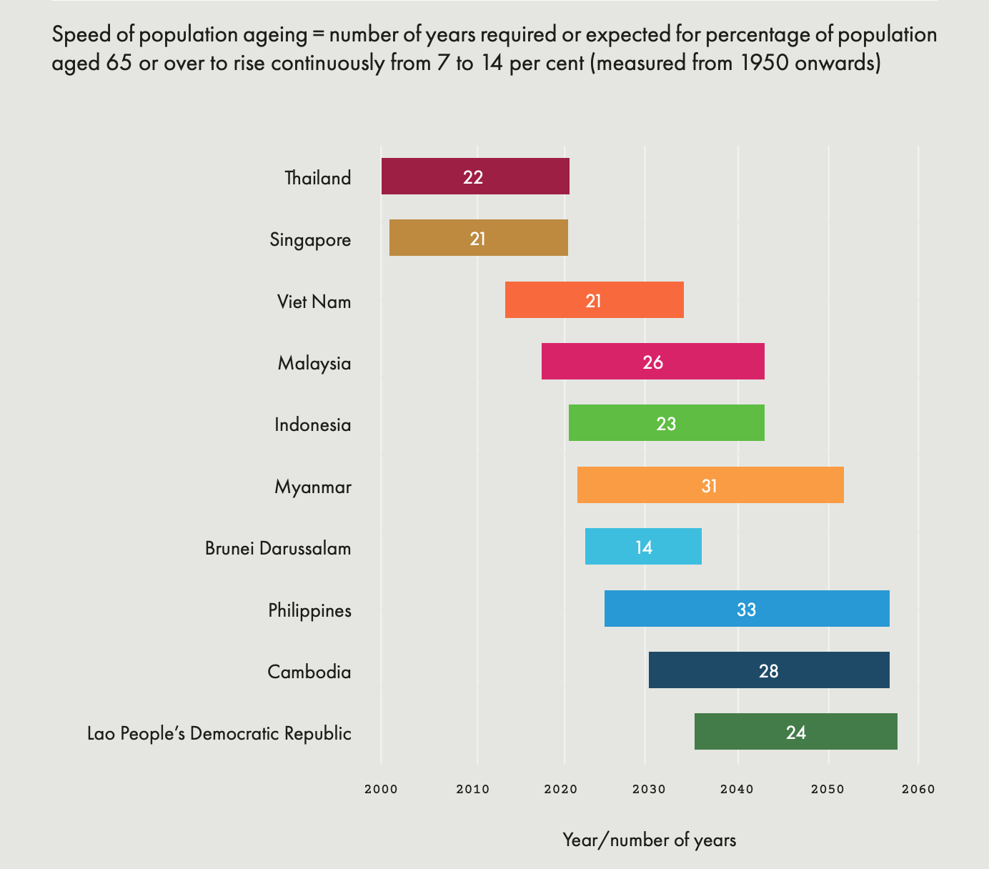
ASEAN countries at different stages of population ageing
Source: ESCAP calculations based on: United Nations, Department of Economic and Social Affairs, Population Division (2019), World Population Prospects 2019, Online Edition and Kinsella, Kevin and Wan He (2009). ”An Aging World: 2008”. International Population and ESCAP (2021), 2020 Older persons in ASEAN in numbers https://bit.ly/35X7vjL

Slide 7


Madrid International Plan of Action on Ageing (MIPAA)
§116 … The aim of the International Plan of Action is to ensure that persons everywhere are able to age with security and dignity and to continue to participate in their societies as citizens with full rights.
Priority direction:
  Older persons and development
  Advancing health and well-being into old age
  Ensuring enabling and supportive environments

Slide 8

MIPAA – pillars and priority directions
Pillar I:
Older persons and development
Pillar II:
Advancing health and
well-being into old age
Pillar III:
Ensuring enabling and supportive environments
1. Active participation in society and development
2. Work and the ageing labour force
1. Health promoting and well-being throughout life
2. Universal and equal access to health-care services
1. Housing and the living environment
2. Care and support for caregivers
3. Rural development, migration, urbanization
4. Access to knowledge, education, training
3. Older persons and HIV/AIDS
4. Training of care providers and health professionals
5. Intergenerational solidarity
6. Eradication of poverty
3. Neglect, abuse and violence
4. Images of ageing
5. Mental health needs of older persons
6. Older persons with disabilities
7. Income security, social protection/social security, poverty prevention
8. Emergency situations

Slide 9
15-65 age cohort shrinks as older cohort grows: a new definition of “working age”
2020
Percentage of
total population
2100
Source: United Nations, Department of Economic and Social Affairs, Population Division (2019),World Population Prospects 2019 - Special Aggregates, Online Edition. Rev 1; United Nations, Department of Economic and Social Affairs, Population Division (2019).

Slide 10
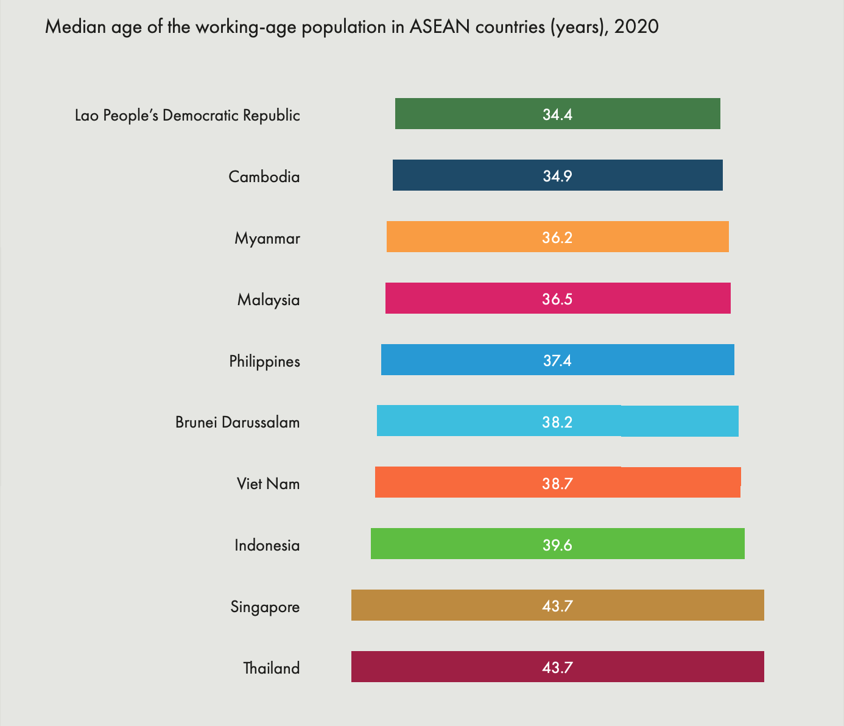
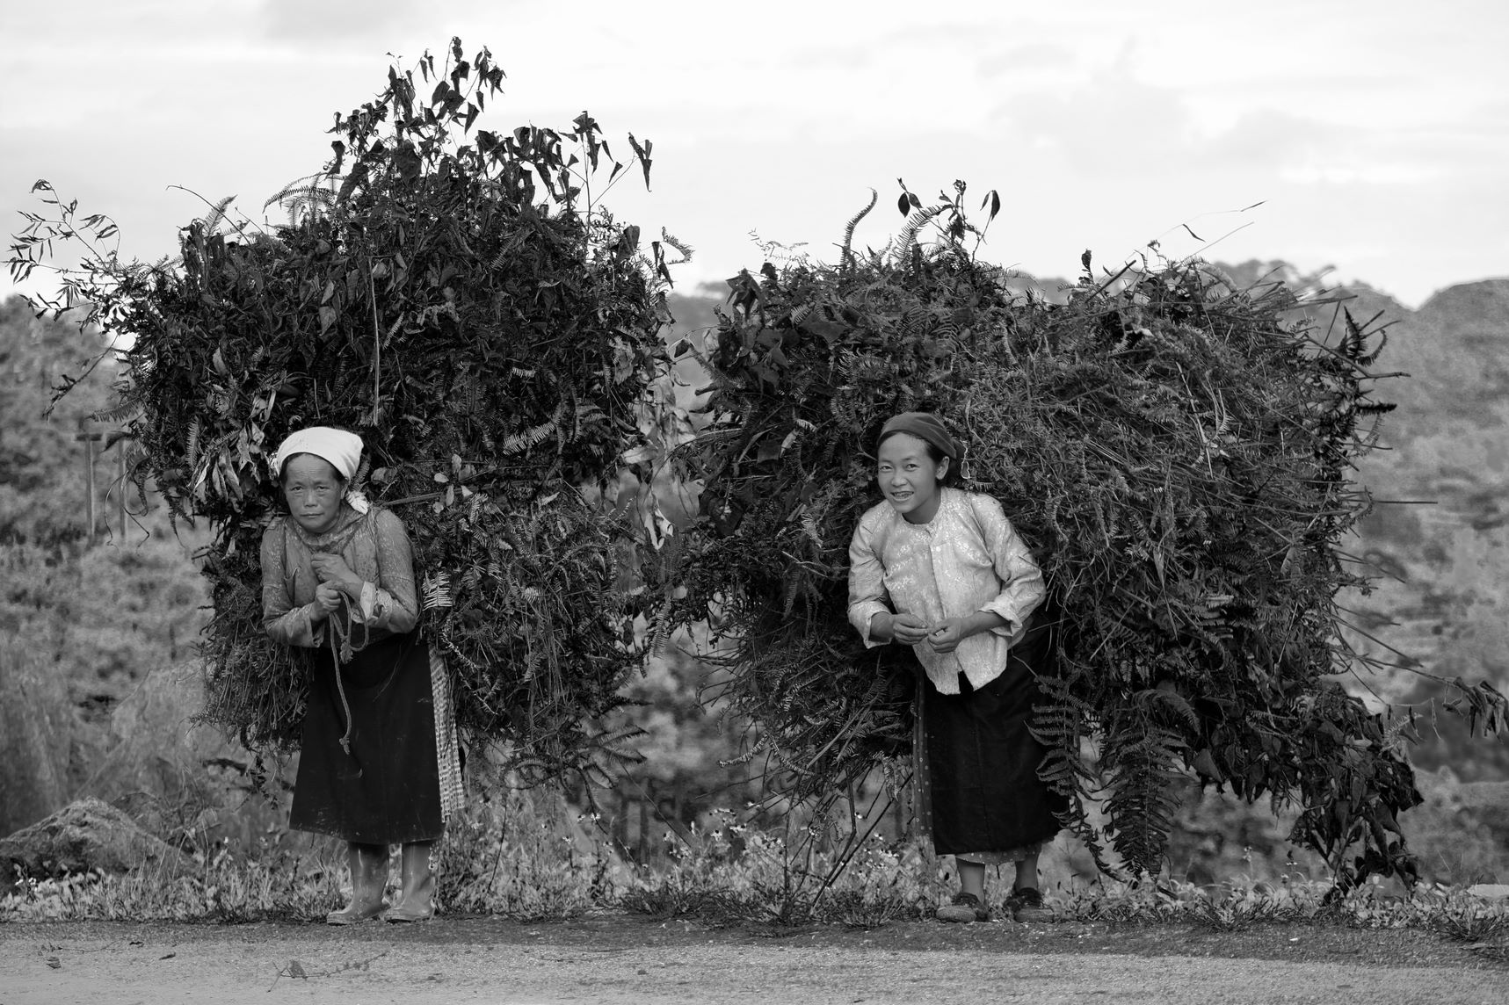
ASEAN labour force is getting older
Source: International Labour Organization (2020). ILOSTAT database. Online. Available from https://ilostat.ilo.org/data/ and ESCAP (2021), 2020 Older persons in ASEAN in numbers https://bit.ly/35X7vjL.

Slide 11
In Asia and the Pacific people live between 19 and 30 years beyond retirement
Life expectancy at the respective retirement age
Source: ESCAP calculations with data from United Nations, Department of Economic and Social Affairs, Population Division (2019), World Population Prospects 2019 - Special Aggregates, Online Edition. Rev 1; United Nations, Department of Economic and Social Affairs, Population Division (2019).

Slide 12
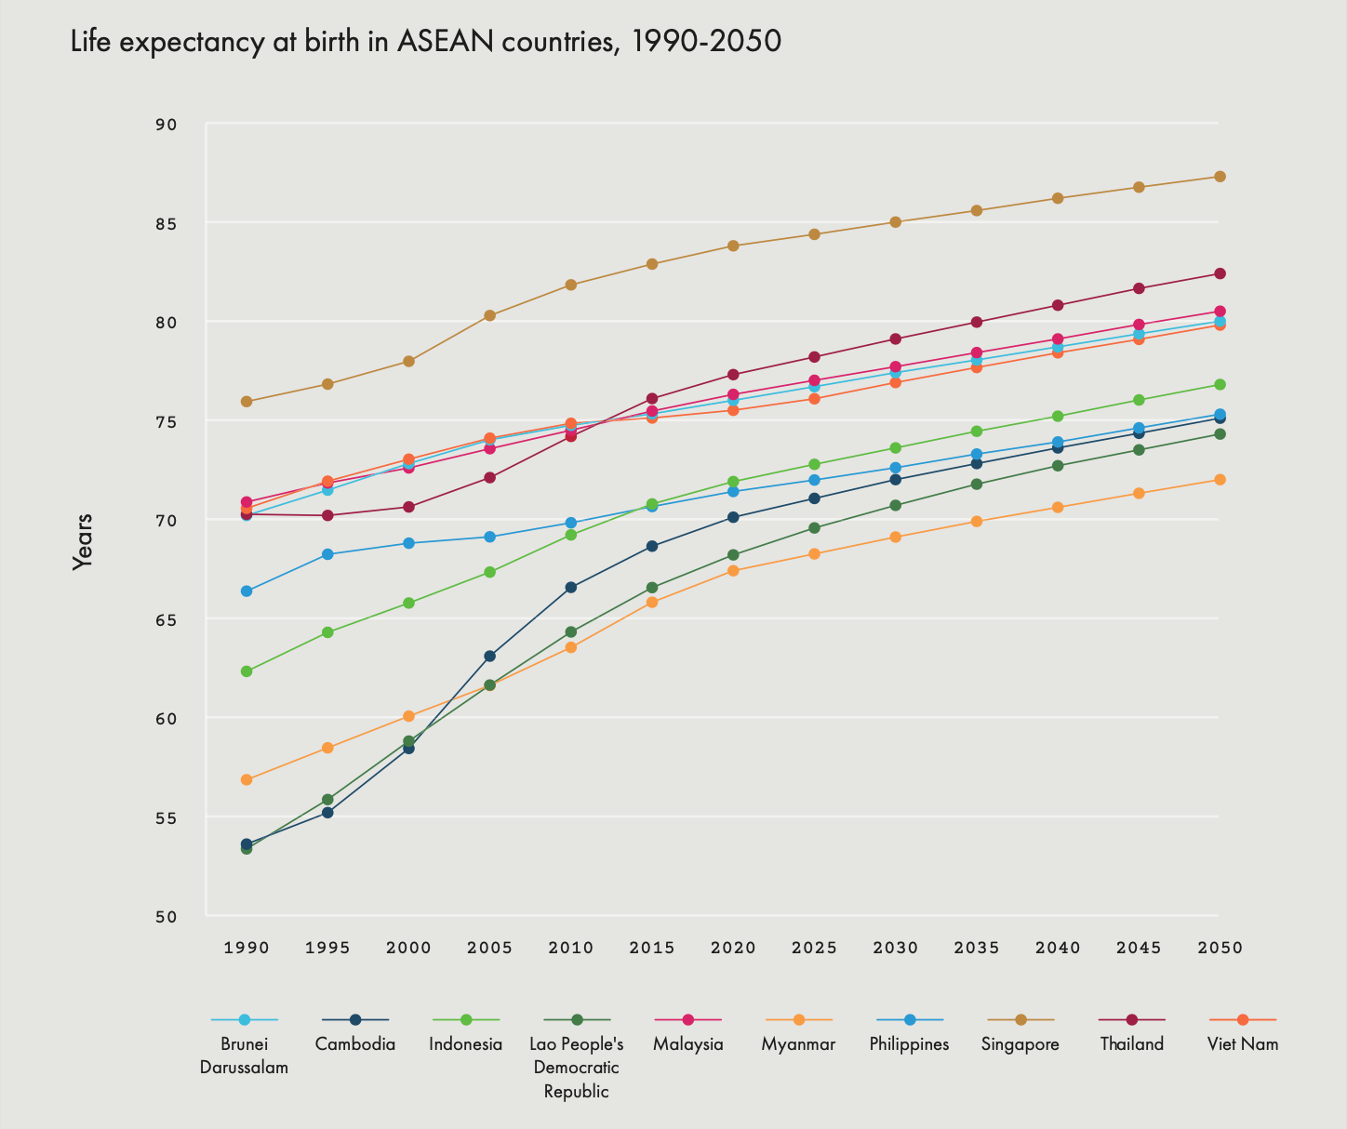
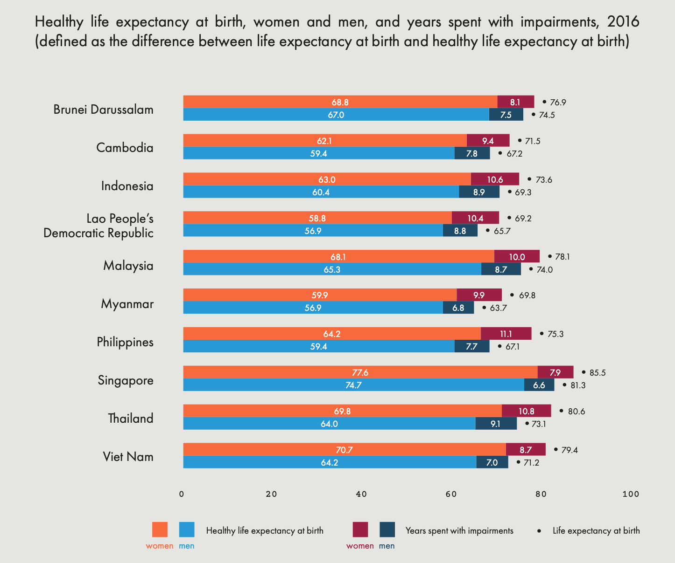
Living longer but not always healthier
Source: ILO, World Social Protection Data Dashboards, online. Accessed 21 April 2021 and ESCAP (2021), 2020 Older persons in ASEAN in numbers https://bit.ly/35X7vjL

Slide 13










60 years
Healthy lifestyle and continuous learning are key to longer and more active lives
60 years
Rethinking work-life to enjoy the extra 20 years throughout life
+ 20 years
Sources: Adapted from Expert Group Meeting on Measuring Population Ageing - Bridging Research and Policy. Healthy ageing – what is it, can we measure it & use it. Dr. Ritu Sadana. Ageing and Life Course, World Health Organization, Geneva (25 February 2019).

Slide 14
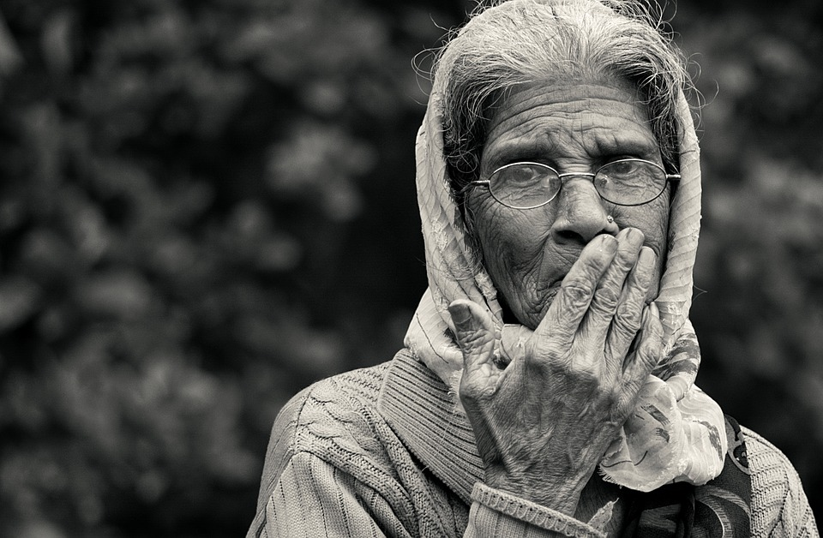
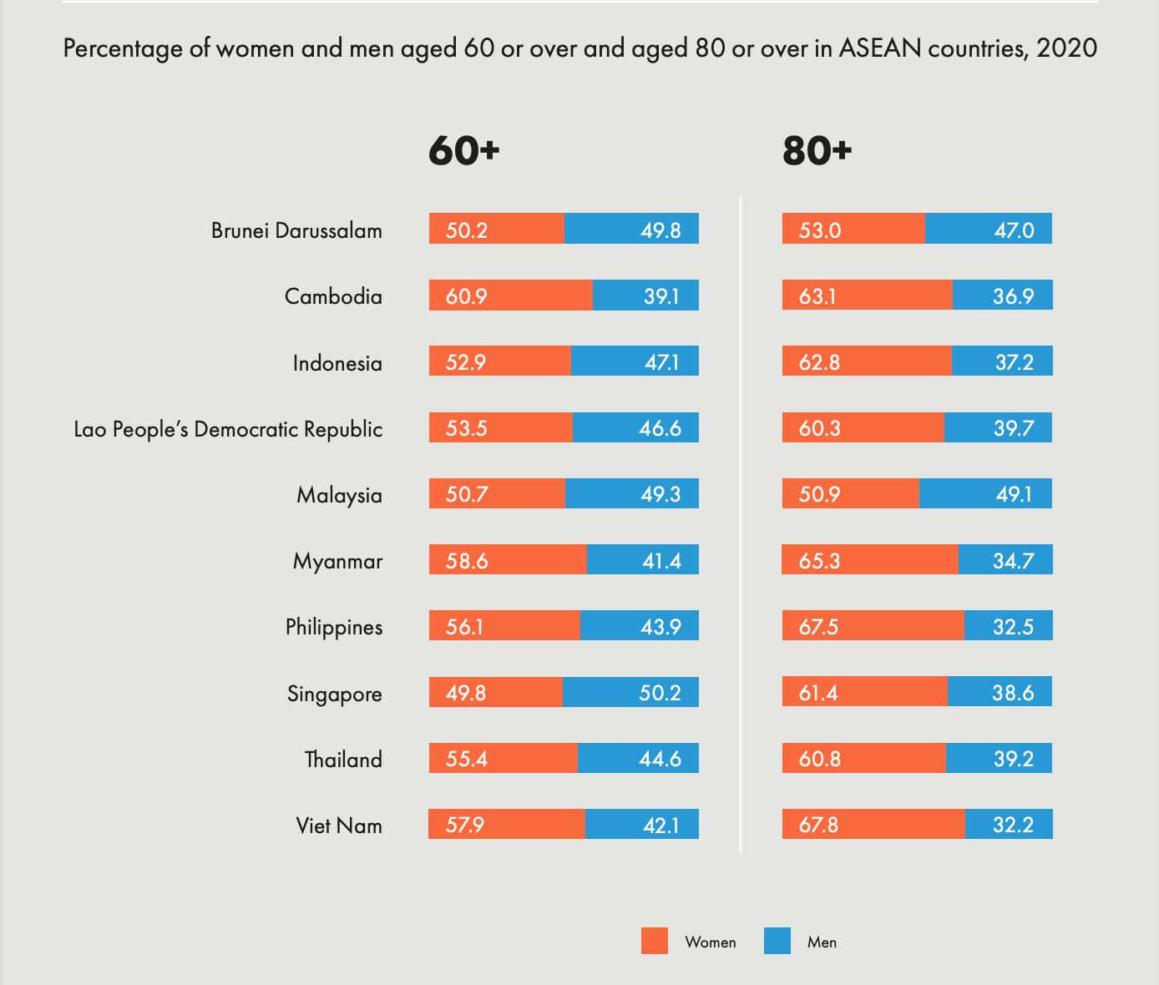
Older women outnumber older men
Source: ESCAP calculations based on United Nations, Department of Economic and Social Affairs, Population Division (2019). World Population Prospects 2019, Online Edition, Rev. 1 and ESCAP (2021), 2020 Older persons in ASEAN in numbers https://bit.ly/35X7vjL

Slide 15
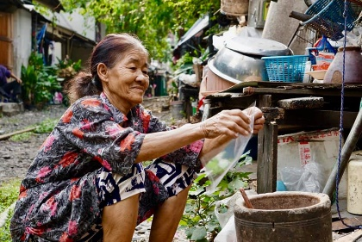
Many informal sector workers in ASEAN
Source: International Labour Organization, ILOSTAT database . SDG Indicator 8.3.1 – Proportion of informal employment in total employment by sex and sector (%) – Annual (Economic Activity: Non-agriculture) Accessed 23 April 2021.

Slide 16
Pension coverage is low in most
ASEAN countries
Source: ILO, World Social Protection Data Dashboards, online. Accessed 21 April 2021

Slide 17

In ASEAN, most older persons (65+) live with their children – but this is changing
Percentage of population aged 65 or over living in a one-person household, latest available year
Source: United Nations, Department of Economic and Social Affairs, Population Division (2018). Database on the Households and Living Arrangements of Older Persons 2018, Accessed 8 October 2019.

Slide 18
Access to technology is important – older persons must be included
Individuals owning a mobile cellular telephone, by gender, percentage of population of the respective broader age group, latest available year
Source: ITU World Telecommunication/ICT Indicators database, 24th Edition, Accessed 23 April 2020

Slide 19
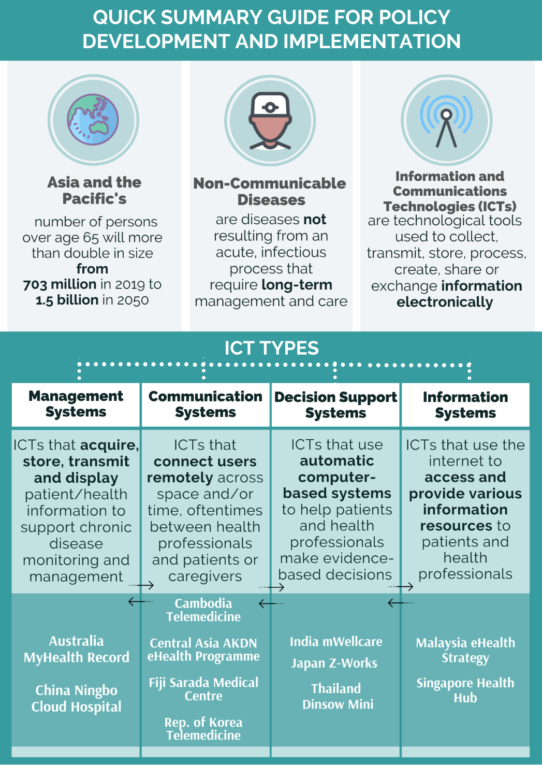
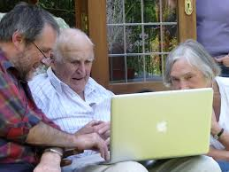
Closing the digital divide for the well-being and decent work of older persons – good practices from Asia and the Pacific
https://bit.ly/3gVdMT9
Source: ESCAP (2021), Enhancing the Role of Information and Communication Technologies in Health Care for Older Persons in Asia and the Pacific, Policy Brief No. 2021/3, https://bit.ly/3qtooMv and ESCAP (2021), Using Information and Communication Technologies to Address the Health-care Needs of Older Persons Managing Chronic Disease –
A Guidebook and Good Practices from Asia and the Pacific https://bit.ly/3gVdMT9

Slide 20
Fourth Review and Appraisal of the MIPAA in Asia and the Pacific – next steps
2021: national reviews (survey) + capacity-building; stakeholder consultations + preparation of documentation
  Jan. – March 2021 nomination of ageing focal points
  June – October 2021: national reviews with survey + capacity-building
  May 2021- May 2022: consultation with MSs, stakeholders, UN entities
  Dec. 2021 – June 2022: preparation of documentation
2022: Regional Review meeting (intergovernmental) Asia and the Pacific
2023: Global Review meeting (intergovernmental) – 61st session Commission for Social Development
2023: 79th session Economic and Social Commission for Asia and the Pacific

Slide 21
THANK YOU
Follow us
www.population-trends-asiapacific.org
www.unescap.org
unescap
unitednationescap
united-nations-escap
unescap
unescap
For further information, please contact: escap-sdd@un.org

